Slide 1

Coursera IBM Capstone Project
The Battle of Neighborhoods

Slide 2
Purpose
his article is part of my final peer reviewed assignment for the IBM Data Science Professional Certificate program —Applied Data Science Capstone.
This is an overview of the project, the project can be found here.

Slide 3
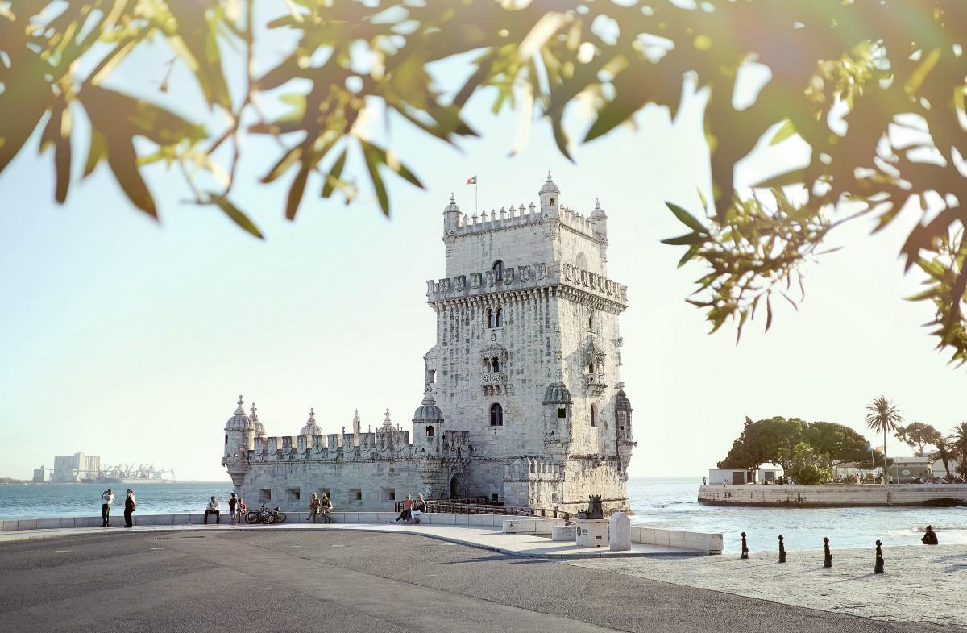
Introduction
Photo by Alex Paganelli on Unsplash
Lisbon is the capital and main city of Portugal. It is a vibrant city with may cultural and touristic attractions and with a significant number of college campus spread across the city. In the last few years there was a boom on the number of foreign exchange students and in the same period there was increasing of foreign tourists visiting the city.
In consequence, we see now more and more restaurants, cafés and bars opening in the main neighborhoods of the city. The demand for more sophisticated places than can provide an improved experience and attract these new customers.

Slide 4
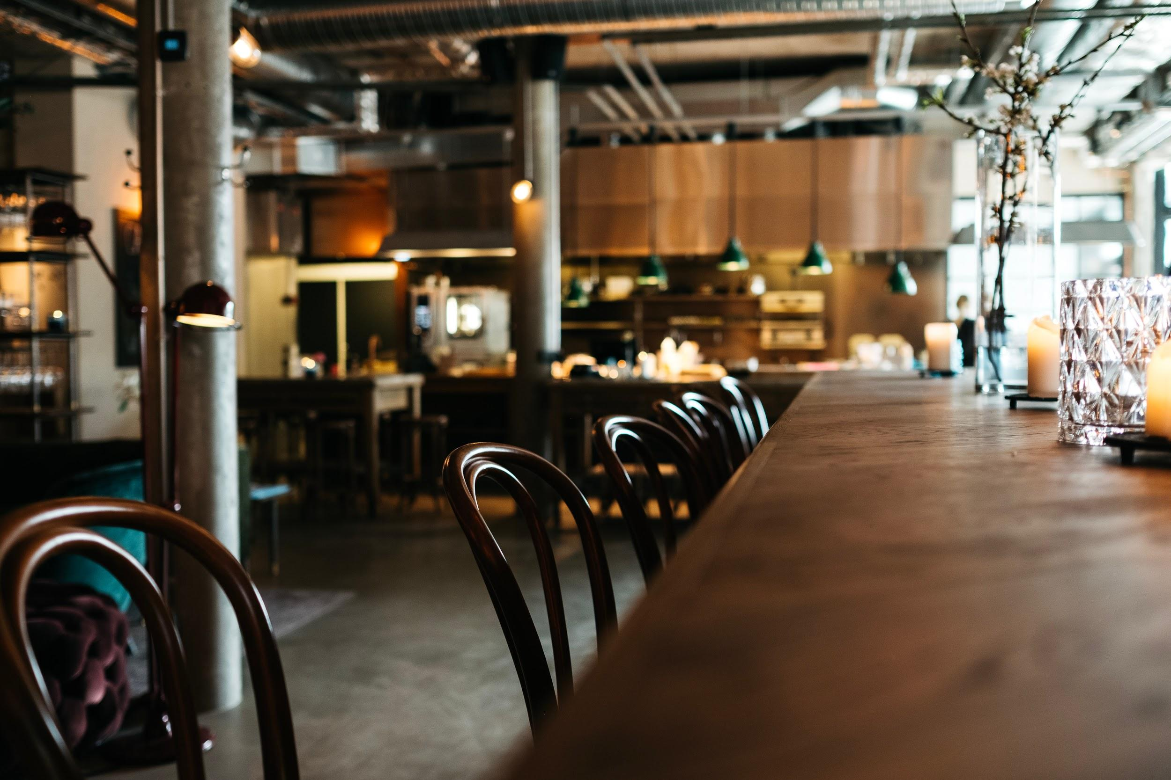
Business Problem
Photo by Jonas Jacobsson on Unsplash
A group of investors is looking to start a new Café concept of addressed to a young and international audience. They also want to place their first location in upper scale neighborhoods, either in the downtown area or in the neighborhoods that have gone through a renovation in recent years.
Another requirement is to place these cafés in areas where already exist other similar venues so they can attract those customer to their new concept of Café.We provide a recommendation based on these criteria.

Slide 5

Data
Photo by Mika Baumeister on Unsplash
Foursquare venue data available through the Foursquare API.
Demographic data for the city of Lisbon from the Portuguese national statistics bureau.
Real estate data from the Portuguese national statistics bureau.
Spatial data for the Lisbon neighborhoods from the Lisbon city council.
Lisbon neighborhoods historic data from the Wikipedia.

Slide 6
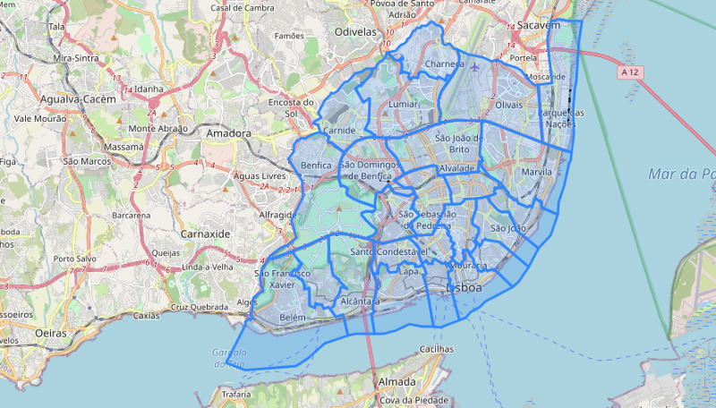
geodata of the neighborhood of the city limits.

Slide 7
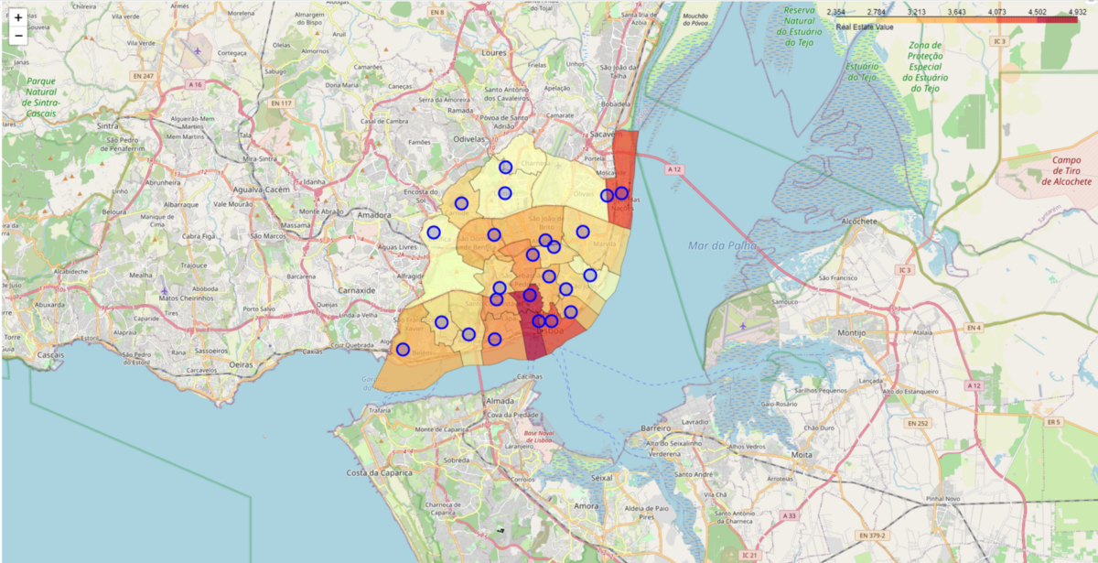
Where is the premium real estate

Slide 8
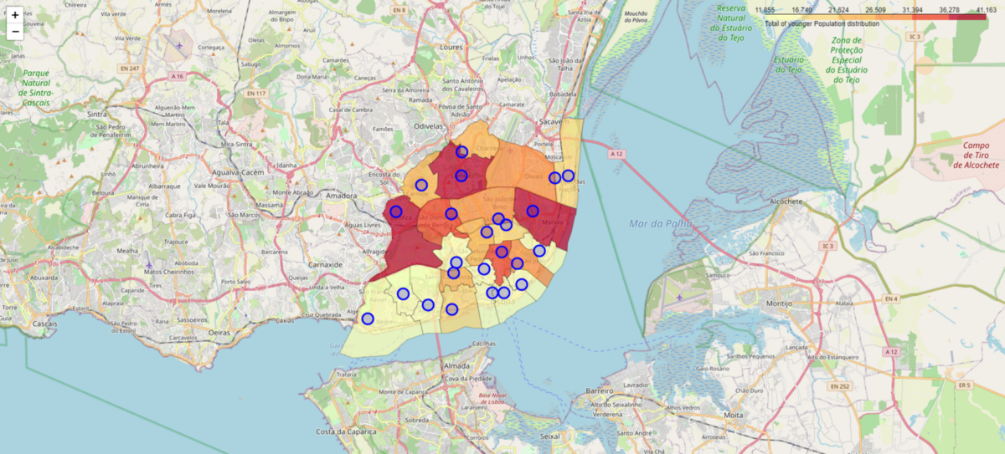
Where is the younger population

Slide 9
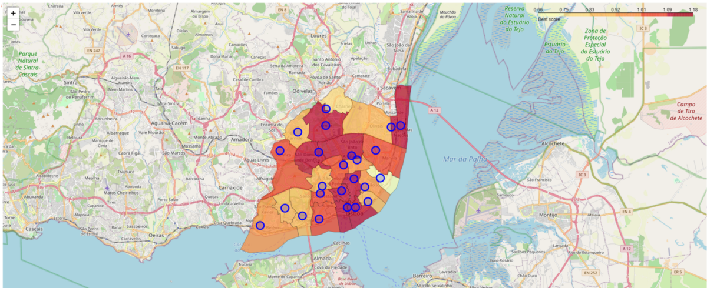
The hooter neighborhoods scoring both inputs

Slide 10
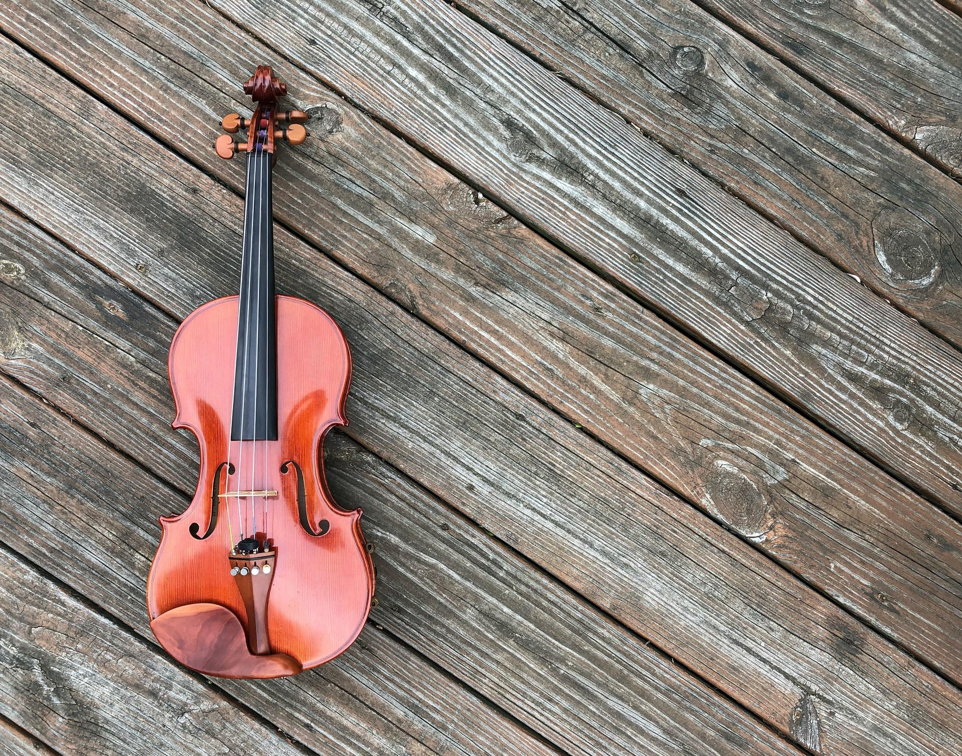
Modelling
Next we will see some violins.
I mean, the venue distribution by neighborhood based of the three categories we are most interested:
Restaurants
Cafés
Bars
Photo by Beth Rufener on Unsplash

Slide 11
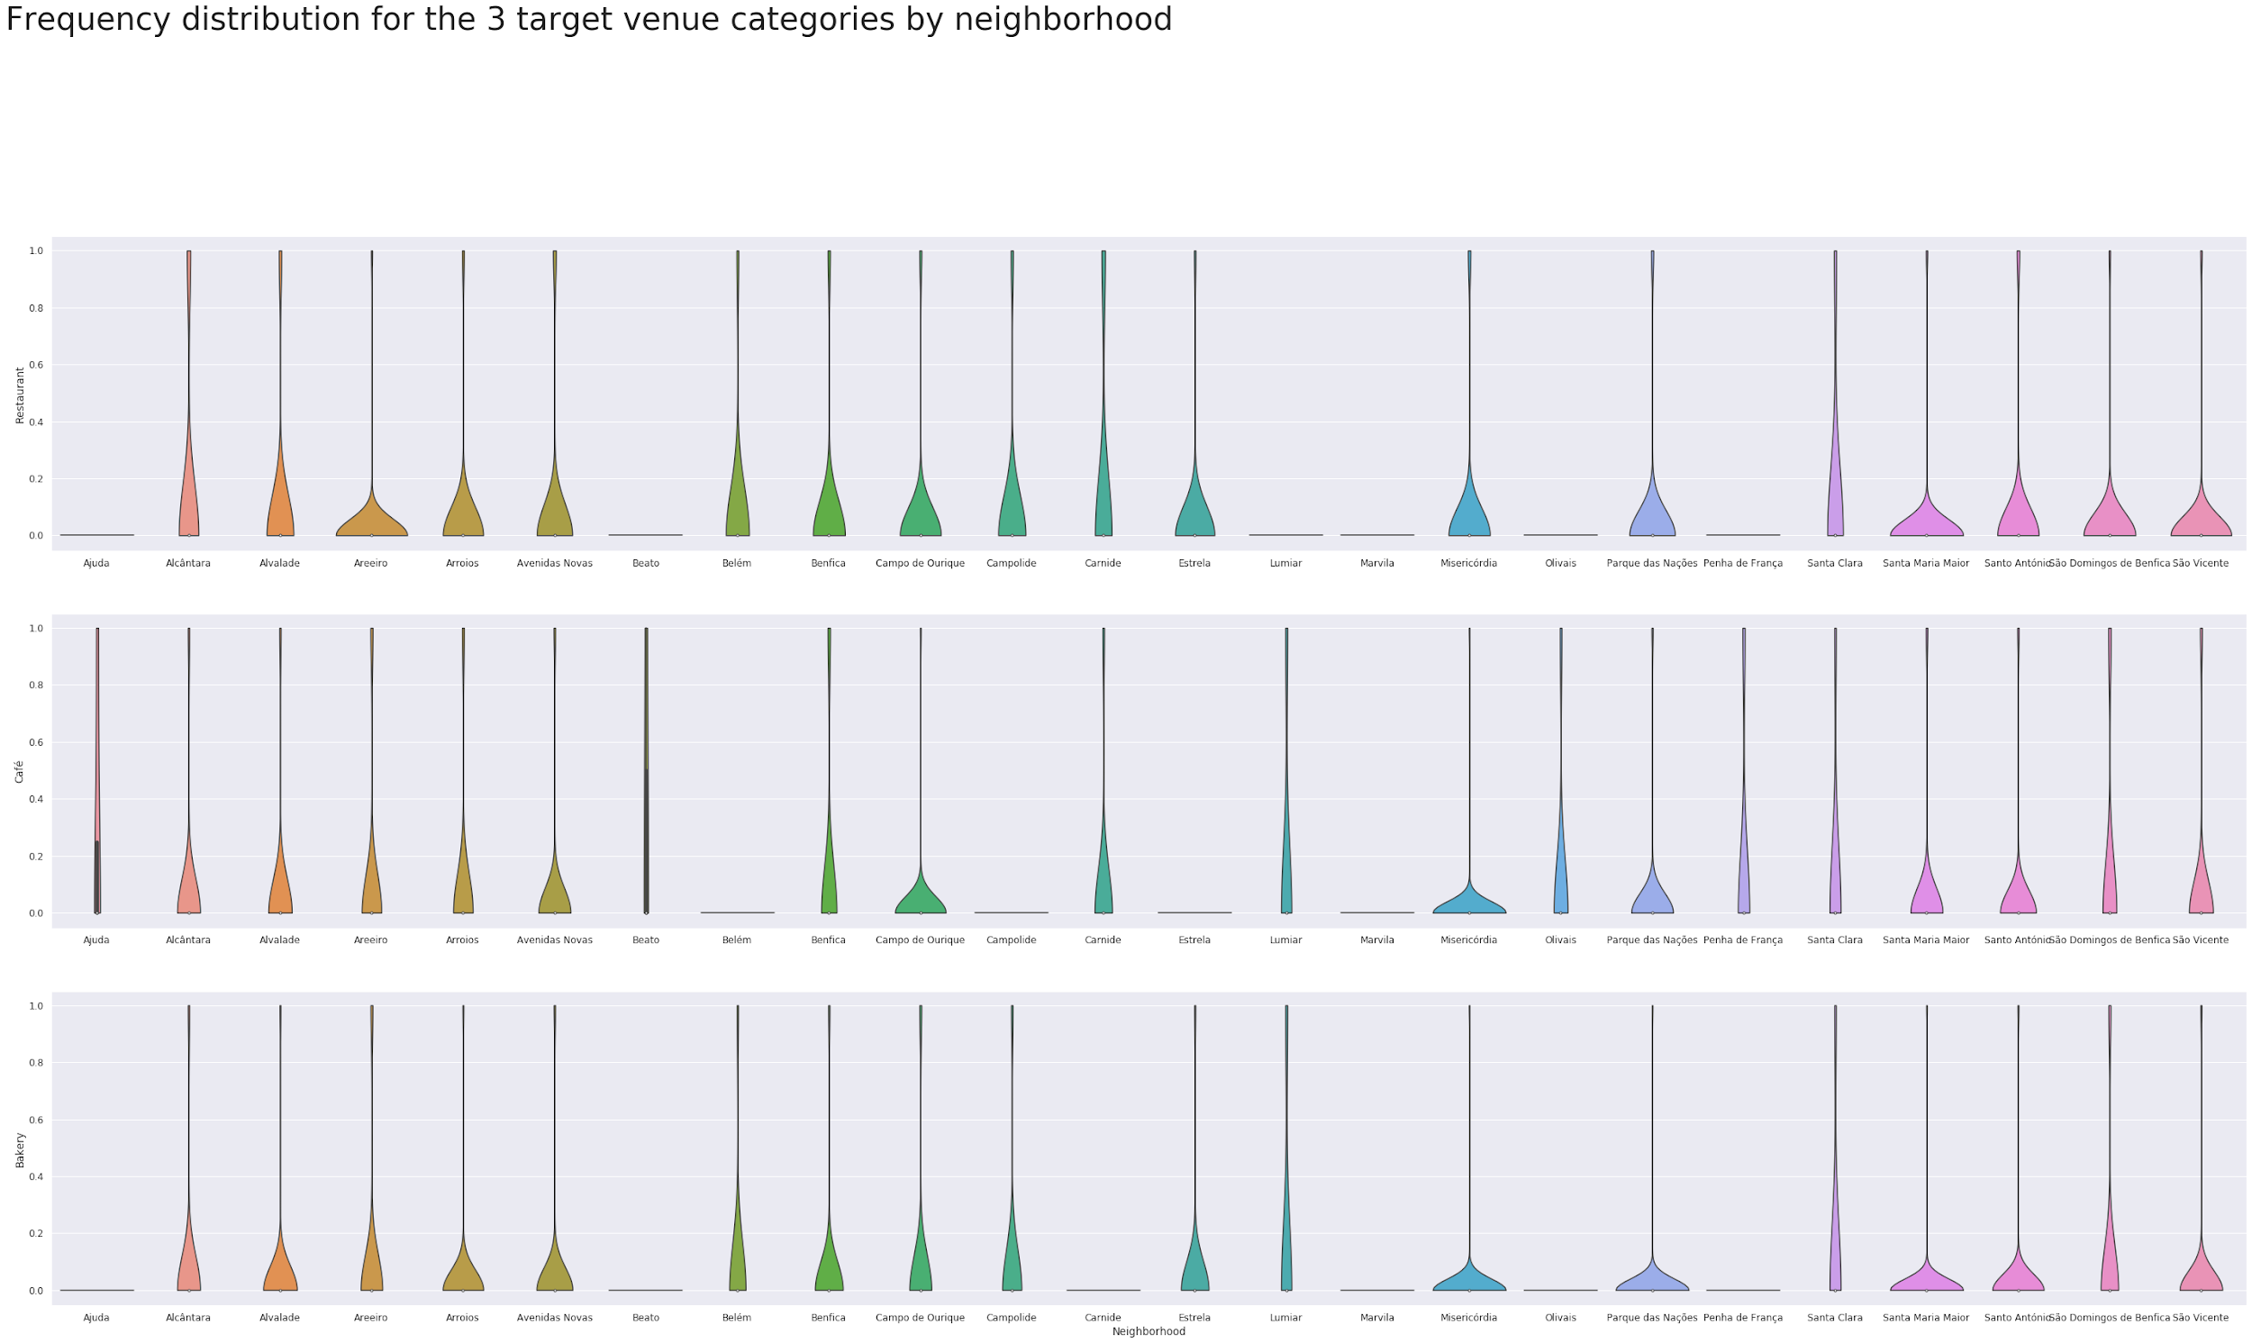
Too many neighborhood to pick from

Slide 12
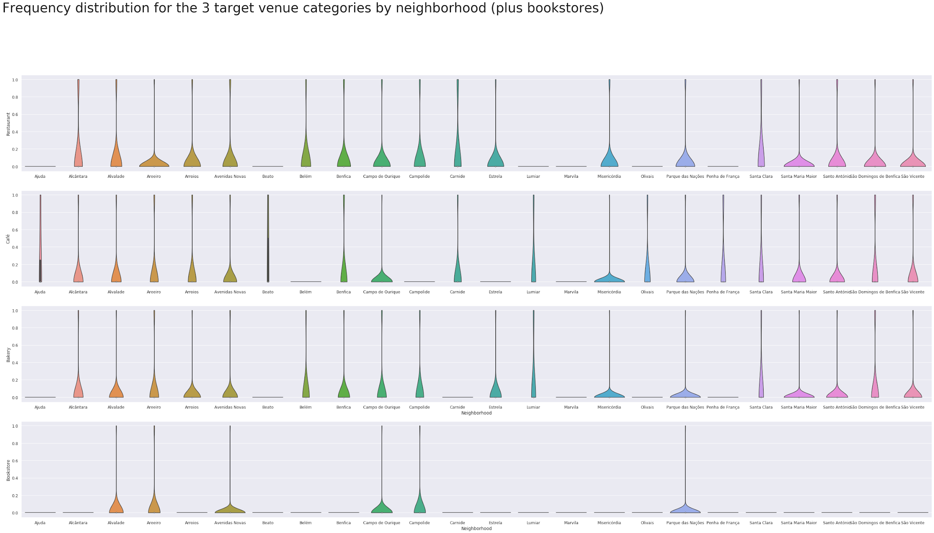
Another of our preferred “neighbors”: bookstores

